Slide 1

THE ADJUSTING PROCESS (Part 1)
Chapter 3

Slide 2
Learning Objectives
Explain Cash basis and Accrual basis of Accounting.
Explain the Revenue and Matching Principles.
Explain why adjustment entries are needed.
Prepare the adjusting entries needed at the end of period. (Prepaid expense & Unearned revenue, Depreciation)

Slide 3
Learning Objectives
Explain Cash basis and Accrual basis of Accounting.
Explain the Revenue and Matching Principles.
Explain why adjustment entries are needed.

Slide 4

Cash Basis Accounting
Cash basis accounting records revenues when cash is received and expenses when cash is paid.
Revenue Jan Feb
Computer repairs fee $2,000 Received cash
Expense
Rent $1,000 Paid cash
Net profit zero
Misleading Financial Statements.
NOT GAAP

Slide 5
Accrual Basis Accounting
Accrual Basis Accounting
GAAP
Records revenues when they are earned and expenses when they are incurred, regardless of the timing of cash receipts or payments.

Slide 6
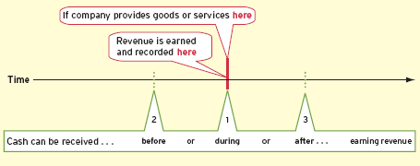
Revenue Recognition Principle
Revenues are recognized in the period when they are earned.
1
Cash is received in the same period as the goods or services are provided.
2
Cash is received in a period before goods or services are provided.
3
Cash is received in a period after goods or services are provided.

Slide 7
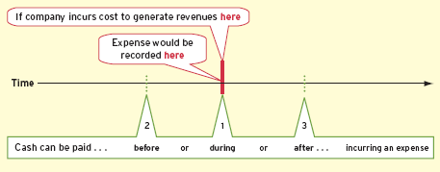
Matching Principle—Expense Recognition
Record expenses in the same period as the revenues with which they can be reasonably associated.
1
Cash is paid at the same time as the cost is incurred to generate revenue.
2
Cash is paid before the expense is incurred to generate revenue.
3
Cash is paid after the cost is incurred to generate revenue.

Slide 8
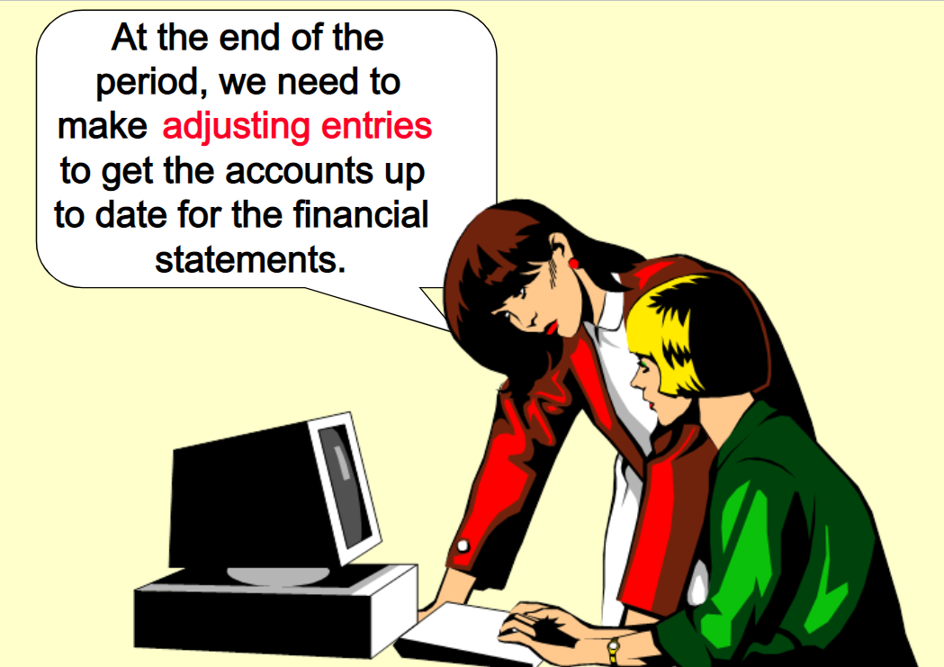
Why Adjustments Are Needed
record most daily transactions, especially involving cash.
cash is not always received in the period in which the company earns the revenue;
cash is not always paid in the period in which the company incurs the expense.

Slide 9
Learning Objectives
Prepare the adjusting entries needed at the end of period.
Prepaid expense

Slide 10
TYPES OF ADJUSTING ENTRIES
Prepaid Expense
Unearned Revenue
2
Cash is paid before the expense is incurred to generate revenue.
Eg. Prepaid insurance, supplies, depreciation
2
Cash is received in a period before goods or services are provided.
Eg. Unearned rent

Slide 11
TYPES OF ADJUSTING ENTRIES
Accrued Expense
Accrued Revenue
3
Cash is paid after the expense is incurred to generate revenue.
3
Cash is received in a period after goods or services are provided.

Slide 12
1. Prepaid Expenses
6 months of insurance were prepaid on Jan 1 for $1,200, but 1 month has now expired, leaving only 5 months prepaid at Jan 31.
1/6 x $1,200 = $200 expense used up as of Jan 31
5/6 x $1,200 = $1,000 asset remains prepaid as of Jan 31
Jan 1
Jan 31
Dec 31
Prepaid $1,200
Adjustment needed

Slide 13
recorded as assets
The costs are expensed as they are used to generate revenue.

Slide 14
Statement of Financial Position
Cost of assets that benefit future periods.
Statement of Profit or Loss
Cost of assets used this period to generate revenue.

Slide 15

At the end of the accounting period, 31 Jan 2022, supplies on hand was $2,100.
recorded as assets
The costs are expensed as they are used to generate revenue.
Supplies Used during the Period
2500 – 2100 = 400

Slide 16
Statement of Financial Position
Cost of assets that benefit future periods.
Statement of Profit or Loss
Cost of assets used this period to generate revenue.

Slide 17
Learning Objectives
Prepare the adjusting entries needed at the end of period.
Unearned revenue

Slide 18
2. Unearned Revenues
1/3 x $1,500 = $500 revenue earned as of Jan 31
2/3 x $1,500 = $1,000 liability remains unearned as of Jan 31
$500
Jan rent
$500
Feb rent
$500
Mar rent
Jan 1
Jan 31
Feb 28
Mar 30
Unearned rent $1,500
Adjustment needed

Slide 19
recorded as liability
Over time, the revenue is recognized as it is earned.

Slide 20
Statement of Financial Position
Liability for future periods.
Statement of Profit or Loss
Revenue earned this period.

Slide 21
Learning Objectives
Prepare the adjusting entries needed at the end of period.
Depreciation

Slide 22
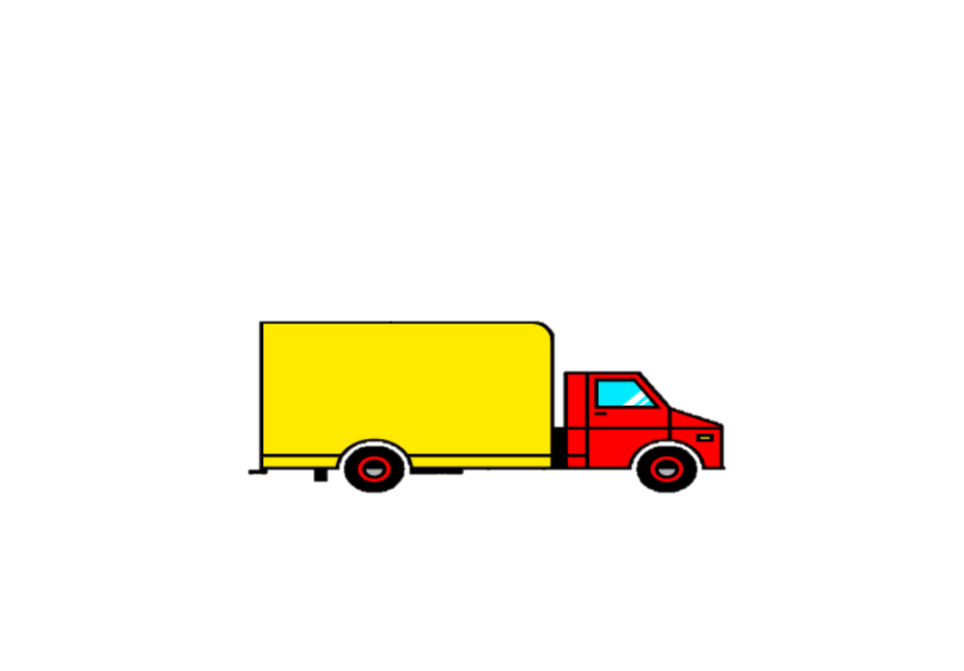
The Concept of Depreciation
Depreciation is the systematic allocation of the cost of a depreciable asset to expense.
Depreciable assets lose value over time as they are used in business to generate revenue.

Slide 23
Asset
Debit
Depreciation Expense
Debit
The asset’s usefulness is partially consumed during the period.
On date when
payment is made
At the end of period…..
Cash
Credit
Accumulated Depreciation (Credit)

Slide 24
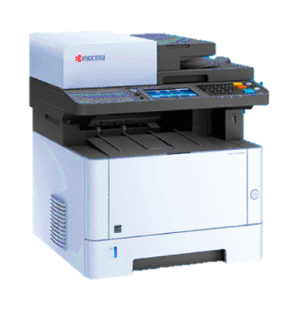
Depreciation Is Only an Estimate
The office equipment has a estimated useful life of 50 months.
Using the straight-line method, the monthly depreciation expense
= Cost of asset____
Estimated useful life
= $10,000 / 50
= $200

Slide 25
Statement of Financial Position
Cost of assets that benefit future periods.
Statement of Profit or Loss
Cost of assets used this period to generate revenue.
Asset
Office Equipment 10,000
Less Accumulated depreciation 600
Net Book Value 9,400

Slide 26

END OF CHAPTER 03
Notes:
End of Chapter 2.

